Slide 1



sample superstpre
View in Power BI
Last data refresh:
8/8/2022 12:26:10 PM UTC
Downloaded at:
7/3/2023 6:10:38 AM UTC

Slide 2
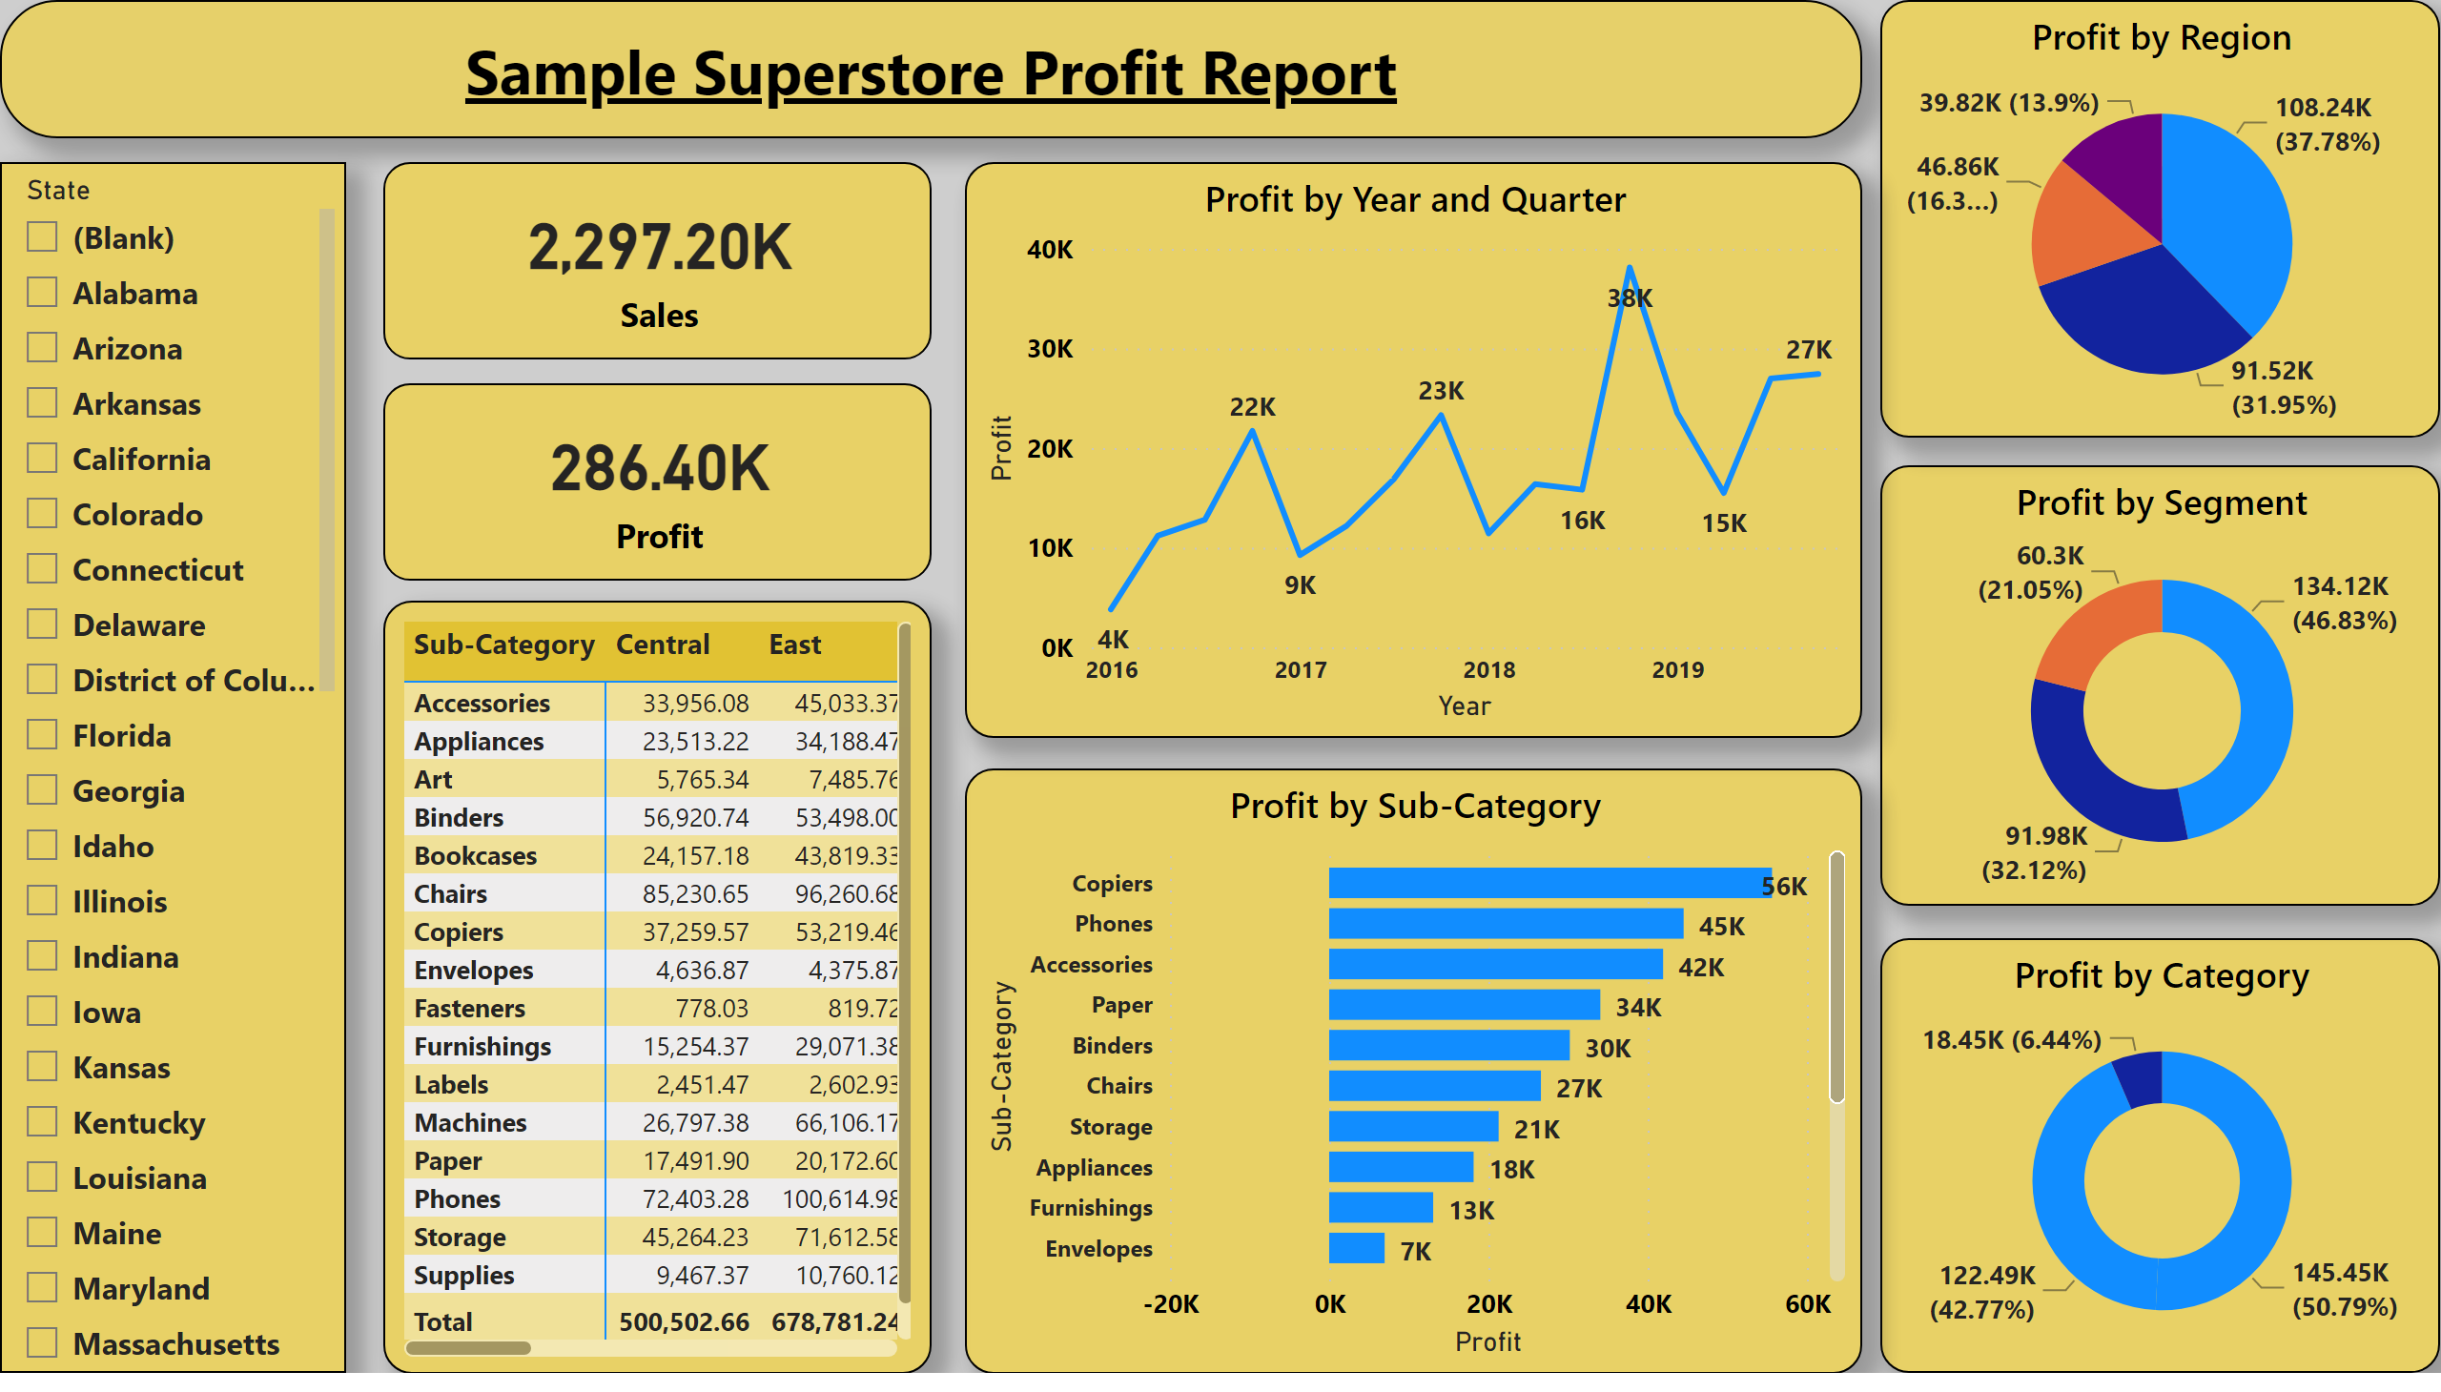
Page 2
Notes:
card
No alt text provided
card
No alt text provided
pivotTable
No alt text provided
slicer
No alt text provided
lineChart
No alt text provided
barChart
No alt text provided
pieChart
No alt text provided
donutChart
No alt text provided
donutChart
No alt text provided
textbox
No alt text provided

Slide 3
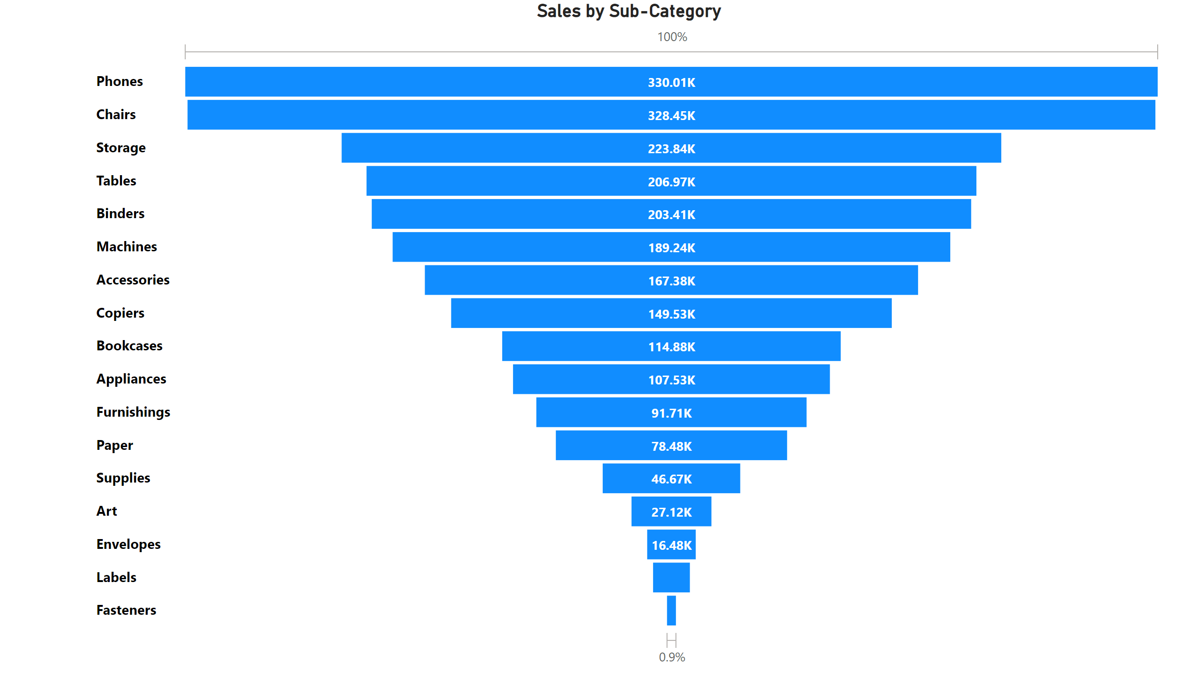
Page 3
Notes:
funnel
No alt text provided

